Slide 1

Presentation Restaurant Management System
Bangladesh University of business and technology

Slide 2
Supervised by:
M. M. Fazle Rabbi
Assistant Professor
Department of Computer Science and Engineering
Bangladesh University of Business and Technology.
Submitted by:
Nazmus Sakib Siam (ID: 18193103049)
Md. Al-amin Hossain Bijoy (ID: 18193103054)
Pallab Sarkar ( ID: 18193103052)
Intake:42, Section: 02
Department of Computer Science and Engineering
Bangladesh University of Business and Technology.

Slide 3
content
Introduction
Objectives
User Modules
Flowchart
Functions
Benefits
Conclusion
Future Works

Slide 4
introduction
Restaurant Management System” is a new generation of restaurant management software beginning with taking orders from customers, ending with billing and tax reports. The user interface is carefully optimized for high speed input of a customer’s order and the prevention of common mistakes. Payments can be accepted by online payment method.
This system has been proposed to be implemented to replace the manual system. The main aim of this project is computerization of all processes which happens in the restaurant.

Slide 5
Objectives
The main objectives of this software are the design, documentation and implementation of a Restaurant Management System. While the subsidiary objectives are:
Increasing productivity, decrease paperwork, and ability to analyze trouble spots.
Increasing the level of services quality and customer satisfaction.
Helping the restaurants to have the ability to build competitive and strategic advantages by better understanding the needs of customers.
Leading organization towards better decision making and building a competitive advantage over its competitors.

Slide 6

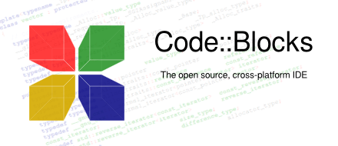
Language & Technology
C Programming Language
Code::Blocks

Slide 7
User Modules
Enter “Menu” to see the available foods
Enter Choice
Enter Quantity of Food
Enter Confirmation (Confirm/Change Item/Cancel)
Enter Name
Enter Payment Method (Bkash/Rocket)
Enter Phone Number
Enter Feedback (not compulsory)

Slide 8
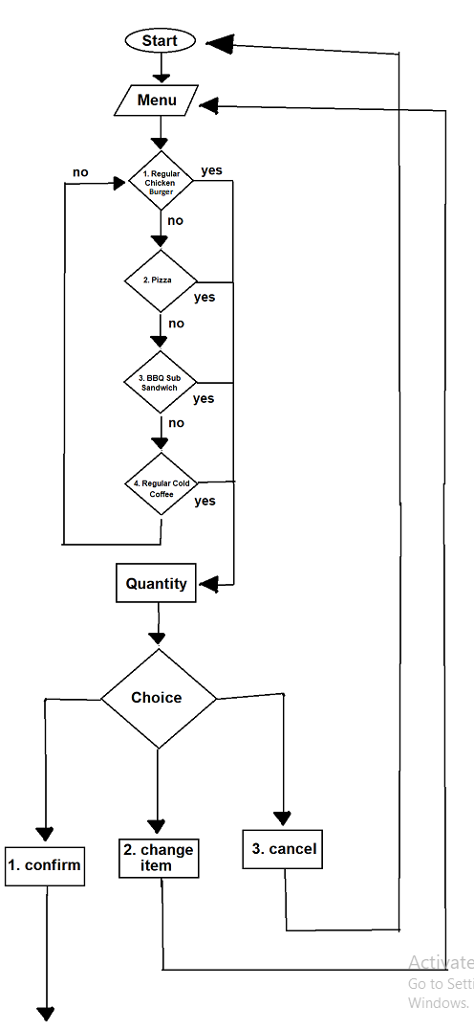
flowchart
Food order and payment method:

Slide 9
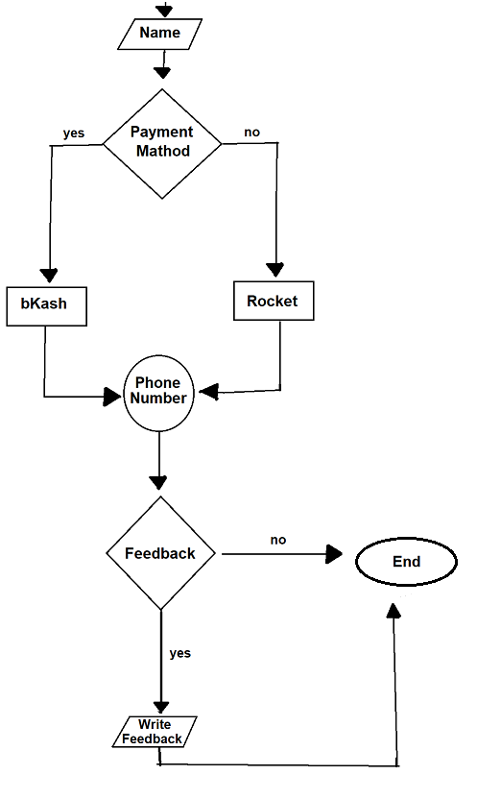

Slide 10
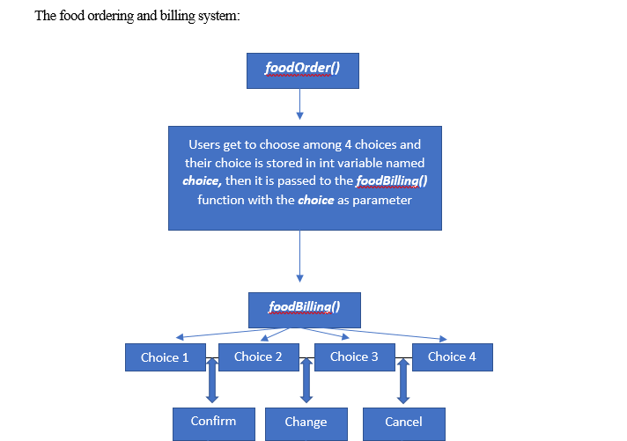
Function

Slide 11
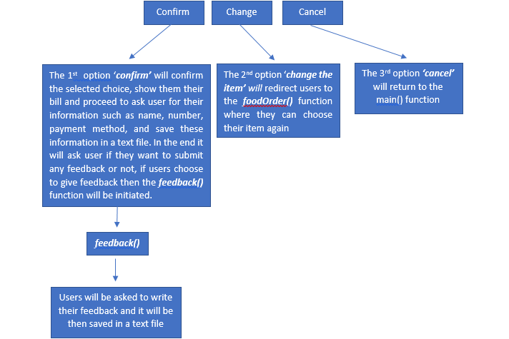

Slide 12
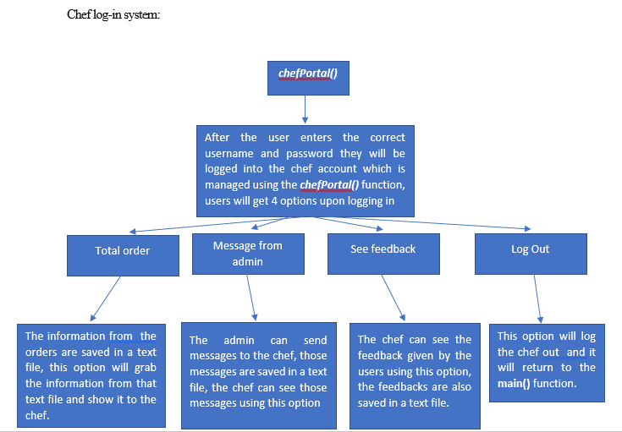

Slide 13
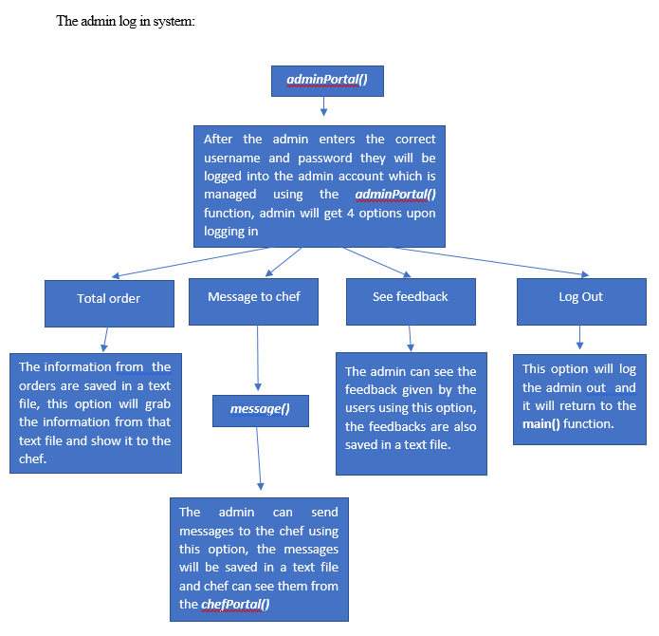

Slide 14
Benefits
User friendly
Saves time
Efficient system
Easy information access
Less Manpower
Better Environment

Slide 15
Conclusion
Today the use of software is becoming vital in the field of Restaurant Management System like- "3 Food". We try our best to develop nice looking, powerful, user friendly and secured software for personal or professional use. We think it is helpful for general people of all categories. We try to fulfill all necessary requirement and feature that provide other online base restaurants, health care or medical service software.

Slide 16
Future Works
The system is fast, convenient and efficient for all customers and personnel of a restaurant. Due to time and cost constraint it was not possible to fulfill all requirements and functionalities which were planned. But in future these planned functionalities and more improvement will be possible to pursue. The functionalities to be implemented are:
Adding food nutrition list.
Providing personalized inbox to the user.
Adding food rating system for customers.
Adding “cart” system for purchasing food.
Adding master card and visa card system.

Slide 17
Thank you

